Slide 1
Microprocessors and Microcontrollers

Slide 2
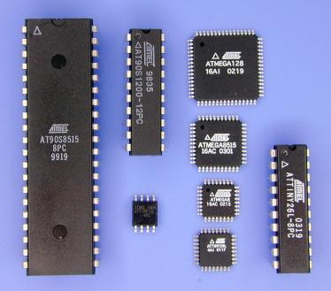
What is a Microcontroller?
What is a microcontroller?
microprocessor
Read-write memory
Flash memory
EEPROM
Input/Output Control
Peripheral Devices (AD/DA)‏

Slide 3
What is a Microcontroller?
Microcontroller is just like a Computer we use everyday, but only in a smaller scale
Contains most of the basic features of a Computer System in a single IC
Can take input
Can provide output
Can perform mathematical calculations and logical operations
And can do much more things

Slide 4
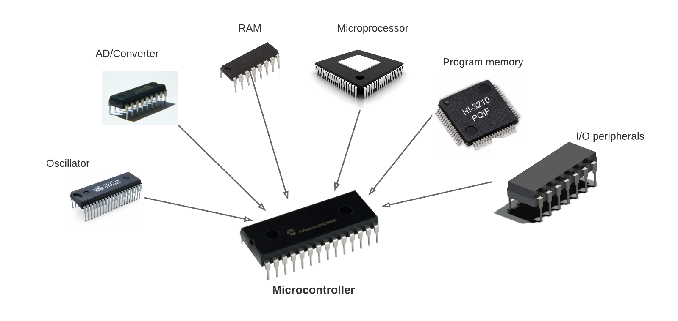

Slide 5
Microcontroller and PC
 | PC | uC
CPU Clock | 3 GHz | 20 MHz
RAM | 512 MB | 1 kB
Hard disk | 80 GB | 16kB
Processor | 32/ 64 bit | 8 bit
OS | Windows | Not required
Input | KB, Mouse | Keypad
Output | Monitor, printer | LCD module

Slide 6
Why use a uC
Emphasis is on cost
Emphasis on power consumption
Easy to use- small package
Enough on-chip-resources
Efficient for high level languages
Dedicated application

Slide 7
Uses of uC
Control systems & Appliances
Robotics
Consumer electronics
Measuring devices
Lock Devices
Hobbyist projects!
Musical instruments
Home automation

Slide 8
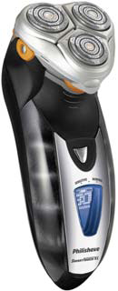
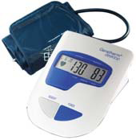
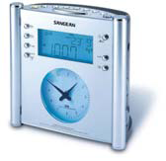
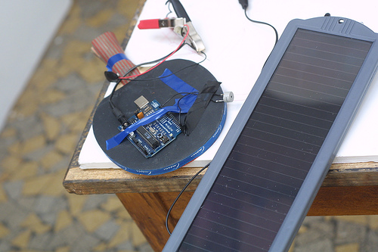
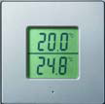
Uses of uC

Slide 9
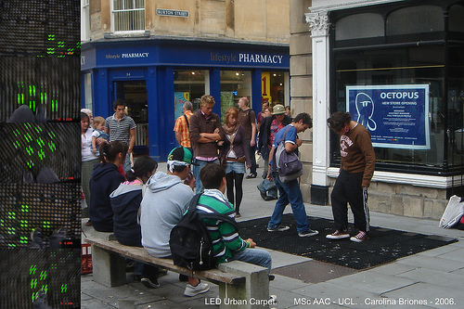
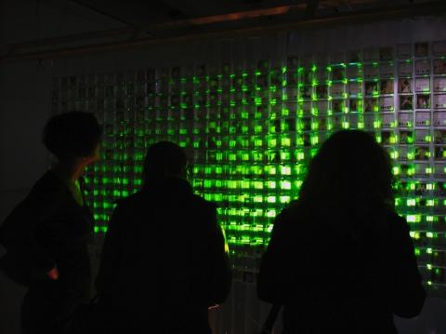

Other Examples

Slide 10
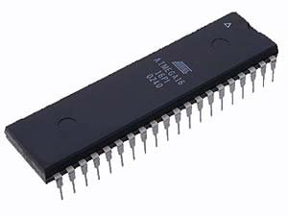

Different Families of Microcontroller
8051
AVR
PIC

Slide 11
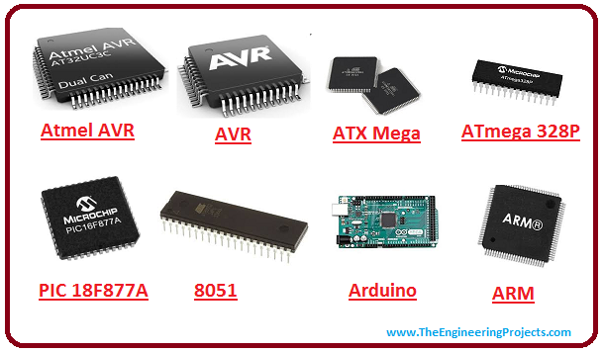

Slide 12
☺

